Slide 1
E-Academy:
Best Team Ever

Slide 2

Problem Statement
Students with difficulties to succeed
Difficulty finding the appropriate academic qualified resources
Tutors not able to find client
This problem affected students from the elementary school level all the way up to the university level
Missing features that improve the quality of life of online tutoring users (guests, students, tutors, teachers, etc.)

Slide 3

Purpose
The E-Academy platform is an online tutoring service that is available to students of all levels
Web-based application tutoring service
Adding features that improves the online tutoring experience
Allowing students to find qualified tutors for the respective subjects that they may struggle in
Ensure standard and fare remuneration for tutors
Flexible and customizable tutoring experience

Slide 4
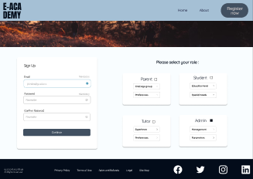
System Features
Core features:
Guests (non-registered user):
Log-in/Sign up
Form to register as student, parent or tutor
Access general section
Student:
Course selection
Upload/download files from archives
Calendar and managing availabilities
Access shared board

Slide 5
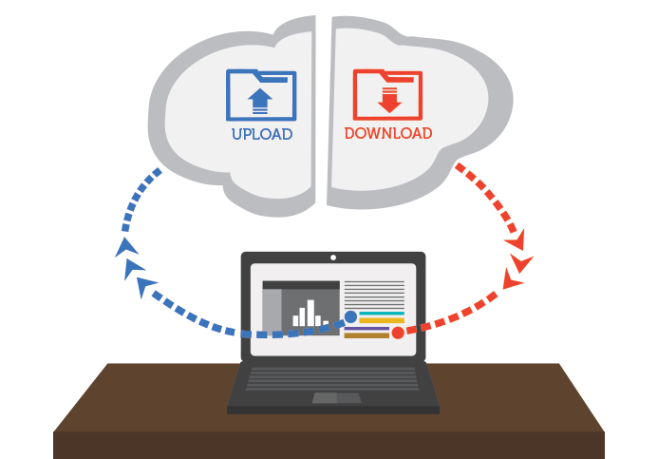

System Features (continuation)
Core features (cont.):
Parents:
Mailing system
View milestones of their children
Tutors:
Upload/download from archive section
Calendar and managing availabilities
Initiate shared board section with student
Administrator:
Account creation
Ability to grant requisition
Ability to link account (student-tutor, parent-student)

Slide 6
System Features (continuation)
Additional features:
Guests (non-registered user):
Chatbot
Student:
Textbook rental service
Forum page
Rate my tutor
Parents:
Tipping tutors

Slide 7
System Features (continuation)
Additional features (cont.):
Tutors:
Set milestones for student
Administrator:
Check tutors online status (active, idle, offline, etc.)

Slide 8

Analysis of Risks
Estimated Project Schedule
Team’s lack of knowledge
Project deliverable
Delay in earlier project phases

Slide 9

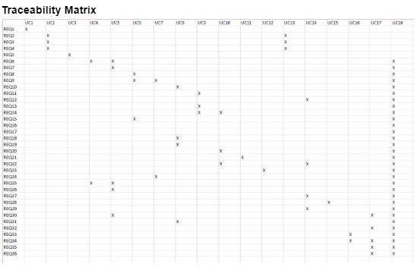
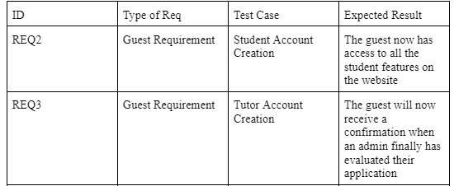
Validation of the Requirements
Validity :
GUI simulation
Using prototypes/mockups to follow up with stakeholders ensuring validity of requirements
Consistency :
Team review to ensure no conflicts
Team to ensure same description for functions
Automatic formal languages consistency checking tools
Completeness:
Traceability matrix
Realism
Within time frame
Within team knowledge
Verifiability:
Requirement reviews
Test cases

Slide 10
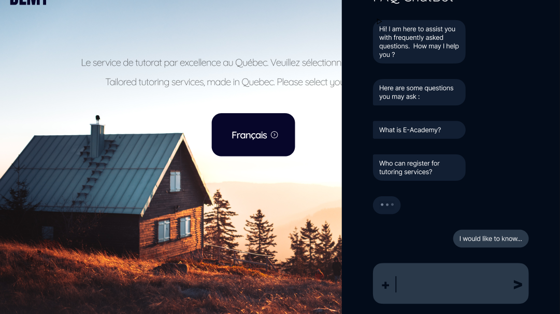
GUI
Landing page +
Chatbot

Slide 11
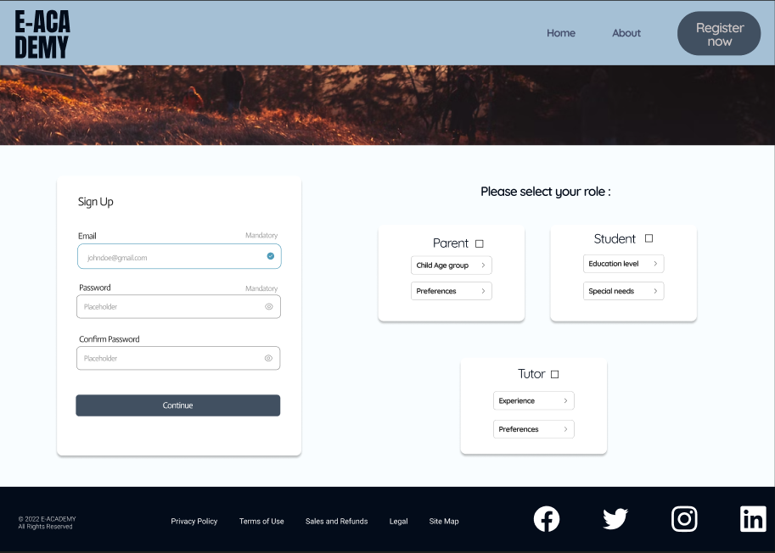
Sign up/Fill a form page

Slide 12
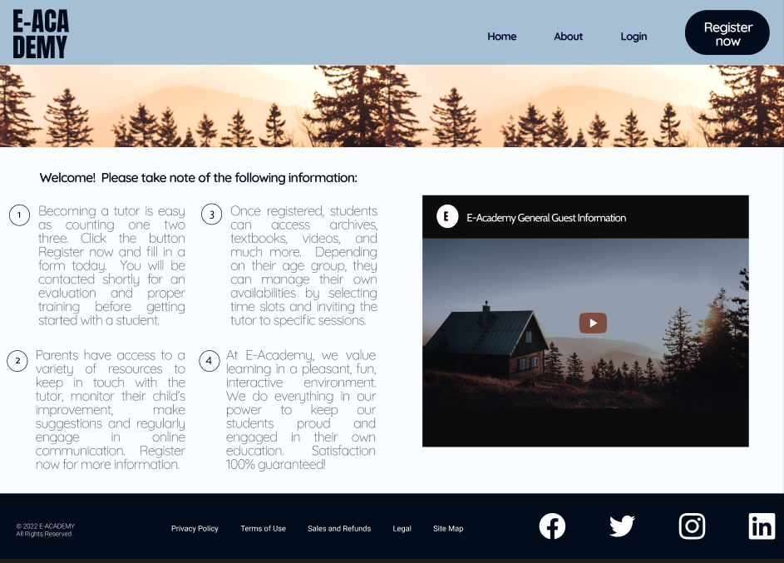
General information page

Slide 13
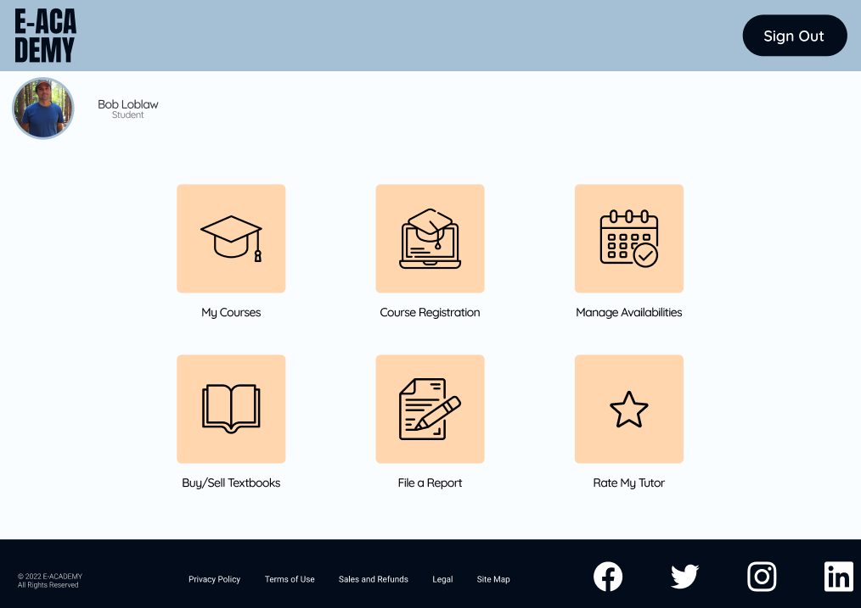
Dashboard

Slide 14
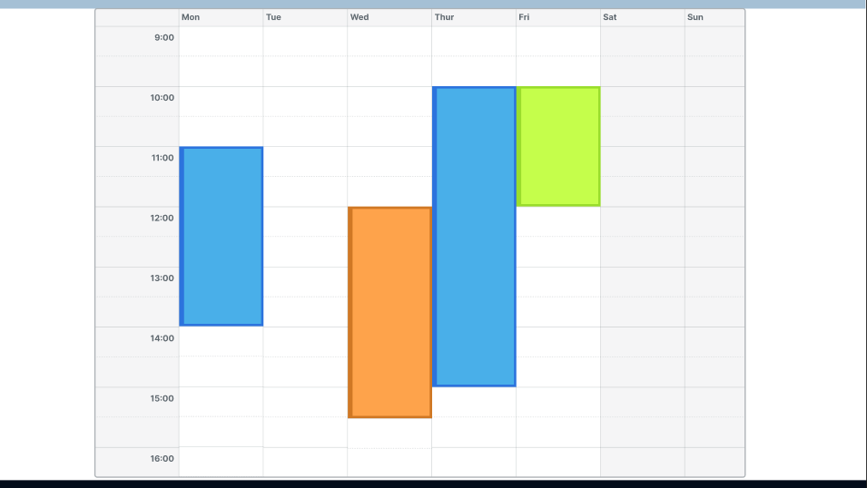
Calendar/Availabilities

Slide 15
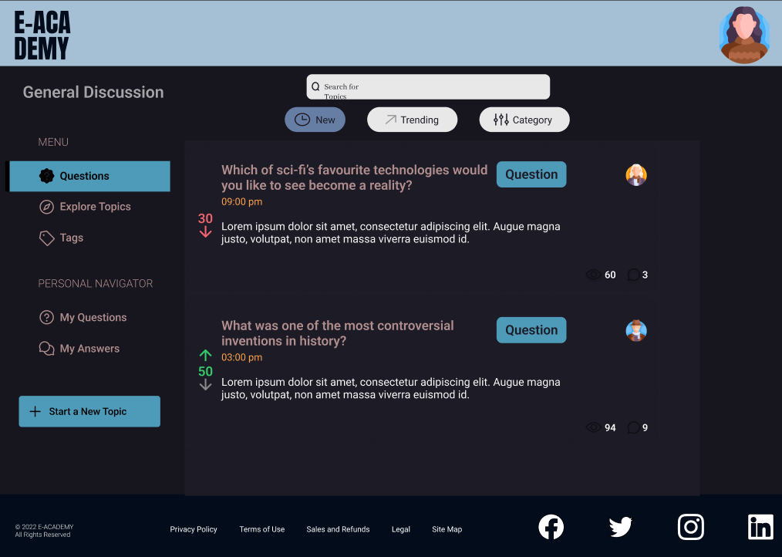
Discussion & Forum

Slide 16
Conclusion

